Slide 1


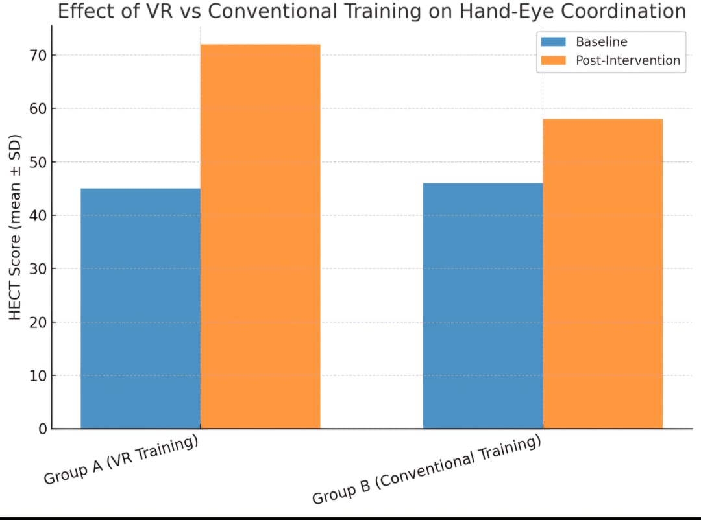
Effect of Virtual Reality Training on Hand-Eye Coordination in Children (A Pilot Randomized Study)
Authors: Dr. A. Kumar¹, Dr. B. Sharma²
¹Department of Pediatrics, ABC Medical College, ²Department of Orthopedics, XYZ University Hospital
INTRODUCTION
RESULTS
CONCLUSION
Hand-eye coordination is vital for child development. Virtual Reality (VR) has emerged as a tool for training motor skills.
Aim: To evaluate whether VR training improves hand-eye coordination in children compared to conventional methods.
VR: A Promising Horizon for Pediatric Rehabilitation
Could be integrated into paediatric rehabilitation programs
METHODOLOGY
DISCUSSION
REFERENCES
Randomized Controlled Study
30 children; 15 in each group
6 weeks
Standardized Hand-Eye Coordination test(HECT)
Smith J. et al. Virtual Reality in Pediatric
Rehabilitation. J Child Dev, 2021.
2. Lee H. et al. Hand-Eye Coordination Training
Methods. Rehab Med, 2020.
VR Drives Significant Improvement
Point increase more in VR group

Slide 2
Effect of Virtual Reality Training on Hand-Eye Coordination in Children (A Pilot Randomized Study)
INTRODUCTION
METHODOLOGY
Hand-eye coordination is vital for child development. Virtual Reality (VR) has emerged as a tool for training motor skills.
Aim: To evaluate whether VR training improves hand-eye coordination in children compared to conventional methods.
Randomized controlled pilot study
30 children (age 6–10 years)
Group A: VR-based training (n=15)
Group B: Conventional training (n=15)
Training Protocol
6 weeks, 3 sessions per week.
Standardized Hand-Eye Coordination test(HECT)

Slide 3

Effect of Virtual Reality Training on Hand-Eye Coordination in Children (A Pilot Randomized Study)
RESULTS
DISCUSSION
VR Drives Significant Improvement
27
12
Point increase for
VR Training Group
Point increase for
VR Training Group

Slide 4
Effect of Virtual Reality Training on Hand-Eye Coordination in Children (A Pilot Randomized Study)
CONCLUSION
REFERENCES
1. Smith J. et al. Virtual Reality in Pediatric Rehabilitation. J Child Dev, 2021.
2. Lee H. et al. Hand-Eye Coordination Training Methods. Rehab Med, 2020.
VR: A Promising Horizon for Pediatric Rehabilitation
Could be integrated into paediatric rehabilitation programs
Limitations:
Small sample size, short follow-up.
Future studies with larger cohorts are needed.

